Slide 1
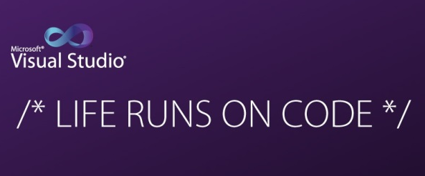
Working with Visual Studio

Slide 2
Introduction
Is a creative launch pad that you use to edit, debug and build code.
Feature-rich program that can be used for many aspects of software development
Nuget support for installing thrid party API/plug-ins in an application.
Includes an excellent debugger that allows you to debug code easily. Step through the application code to understand it line by line, or identify problems in your code.

Slide 3
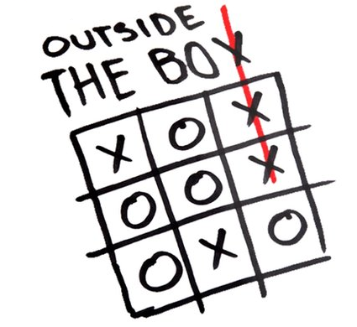
Outside the box
C# provides conventional methods to code along with enhanced functionality to write code more efficiently. Both conventional and enhanced versions of coding can be mixed.

Slide 4
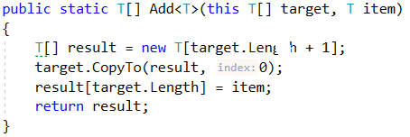
Outside the box
Example working with array type
In most languages to add elements a resize method is used e.g. for C#
Since C# is extendable an extension can be created, T is the type of array e.g. int, string etc.
An array can be created by specifying a range
double[] balance1 = { 23.0, 24.00, 25.0 };
Array.Resize(ref balance1, 12);
double[] balance2 = Enumerable.Range(23, 3).Select(Convert.ToDouble).ToArray();

Slide 5
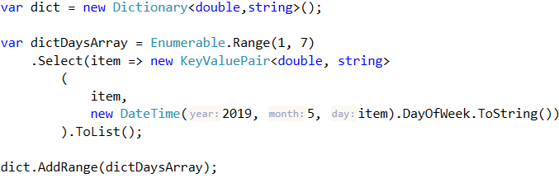
Out of the box
In the prior example Enumerable.Range is overkill but consider creating a dictionary. Here a empty Dictionary is created followed by creating items to add to the new dictionary.
The last method, AddRange is a language extension which is a generic method meaning we are not hard code to the above dictionary contruct.
Continue next slide

Slide 6
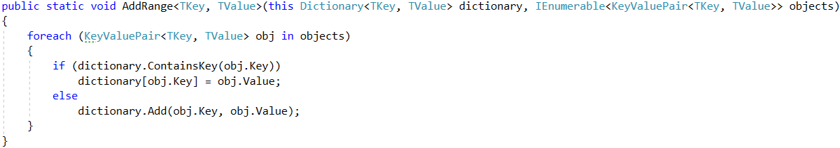
Out of the box
Going with the last code example, this is a generic method/extension which accepts any type of dictionary.

Slide 7
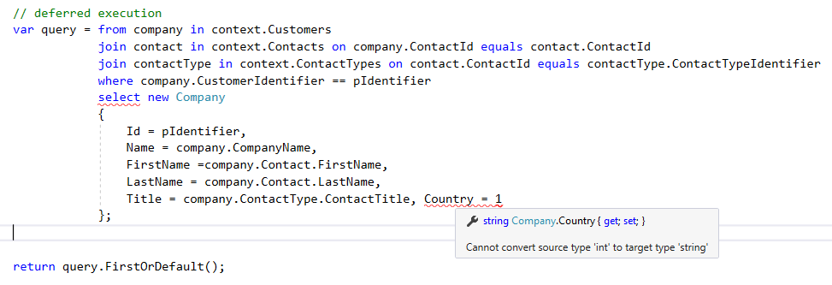
Popular productivity features
Squiggles Squiggles are wavy underlines that alert you to errors or potential problems in your code as you type

Slide 8


Popular productivity features
Quick Actions let you easily refactor, generate, or otherwise modify code with a single action. Quick Actions can be applied by using the light bulb or screwdriver or by pressing CTRL+.
This item is when Resharper is installed which is another layer of helper/assistance.
Suggestions, create a list as shown here.
Note the squiggles, a refactor is being recommended.

Slide 9
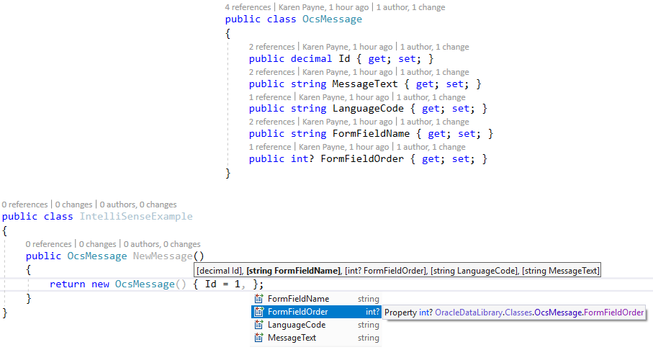
IntelliSense
IntelliSense is a term for a set of features that displays information about your code directly in the editor and, in some cases, write small bits of code for you. It's like having basic documentation inline in the editor, which saves you from having to look up type information elsewhere. IntelliSense features vary by language.

Slide 10
IntelliSense
The IntelliSense completion lists in C# contain tokens from List Members, Complete Word, and more. It provides quick access to:
Members of a type or namespace
Variables, commands, and functions names
Language keywords
Extension methods
The completion list in C# is also smart enough to filter out irrelevant tokens and pre-select a token based on context.

Slide 11
Navigate code
Visual Studio provides numerous ways to navigate code in the editor. This topic summarizes the different ways you can navigate your code.
https://docs.microsoft.com/en-us/visualstudio/ide/navigating-code?view=vs-2019
Shortcuts
http://visualstudioshortcuts.com/2017/

Slide 12
Test-first development with the Generate From Usage feature
Test-first development is an approach to software design in which you first write unit tests based on product specifications, and then write the source code that is required to make the tests succeed. Visual Studio supports test-first development by generating new types and members in the source code when you first reference them in your test cases, before they are defined.
Visual Studio generates the new types and members with minimal interruption to your workflow. You can create stubs for types, methods, properties, fields, or constructors without leaving your current location in code. When you open a dialog box to specify options for type generation, the focus returns immediately to the current open file when the dialog box closes.

Slide 13
Create and run unit tests for managed code
This article steps you through creating, running, and customizing a series of unit tests using the Microsoft unit test framework for managed code and Visual Studio Test Explorer. You start with a C# project that is under development, create tests that exercise its code, run the tests, and examine the results. Then you change the project code and rerun the tests.
https://docs.microsoft.com/en-us/visualstudio/test/walkthrough-creating-and-running-unit-tests-for-managed-code?view=vs-2019

Slide 14
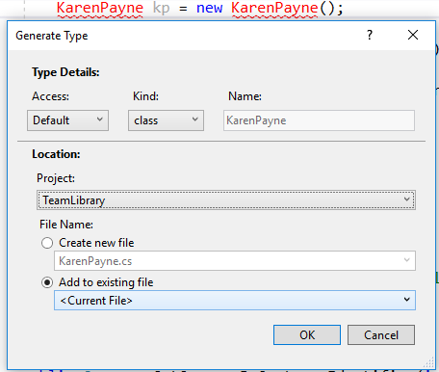
Generate from usage

Slide 15
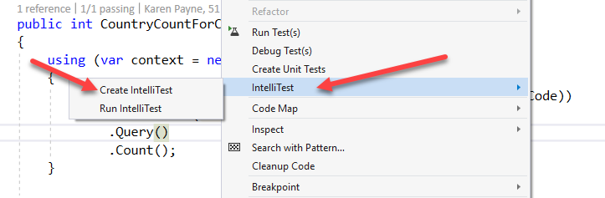
Use IntelliTest

Slide 16
C# Reference/C# Guide
C# keywords, operators, special characters, preprocessor directives, compiler options, and compiler errors and warnings.
https://docs.microsoft.com/en-us/dotnet/csharp/language-reference/
The C# guide provides many resources about the C# language. This site has many different audiences. Depending on your experience with programming, or with the C# language and .NET, you may wish to explore different sections of this guide.
https://docs.microsoft.com/en-us/dotnet/csharp/index
For brand new developers
For developers new to C#
Experienced C# developers:
Using resources on the web – example (style of author)
https://www.tutorialspoint.com/csharp/index.htm
https://www.tutorialsteacher.com/csharp/csharp-tutorials

Slide 17
C# Good to know
Everything is a class in C#
Web and service projects starting point is the main project, program.cs
Class project have no entry point class, classes may via ctor.
C# is case sensitive, example, firstName is different than FirstName.
C# string concatenation “Karen ” + “Payne” (see next bullet)
C# $ - string interpolation.
C# math, +, +=, ==, -, -=, *= etc
C# strings use StringBuilder for large strings.
C# String class - explore

Slide 18
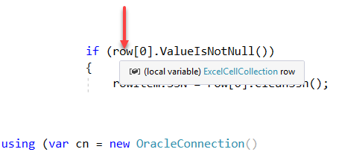
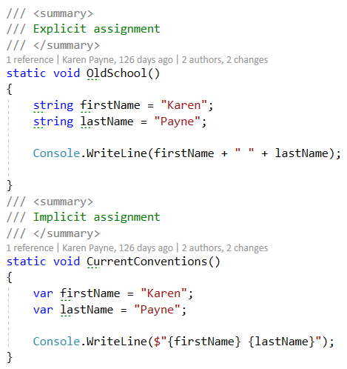
C# Good to know
Declaring

Slide 19

Escaping
\\ and @ verbatim

Slide 20
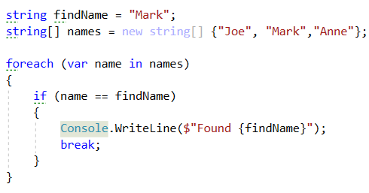
Old school
Find item in array

Slide 21
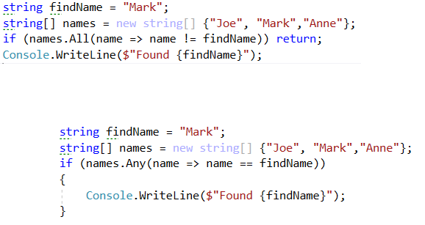
New school
Find item in array

Slide 22
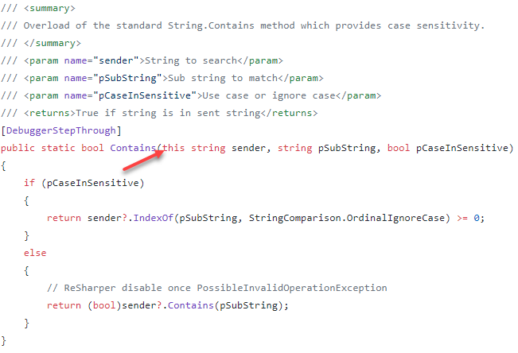
C# Good to know
Classes may be extended using extension methods

Slide 23
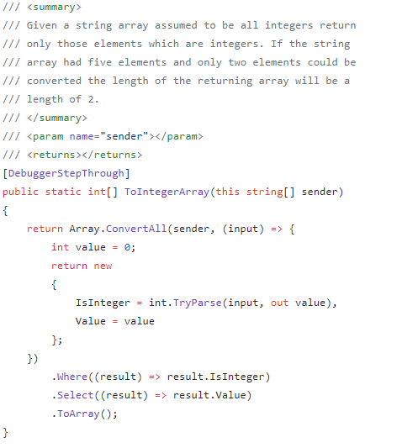
C# Good to know
Classes may be extended using extension methods

Slide 24
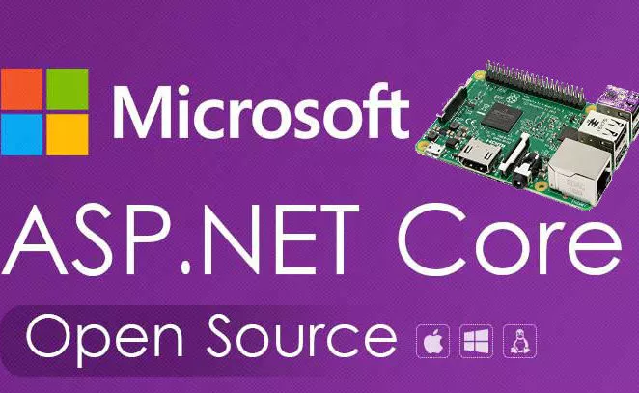

Slide 25
ASP.NET Core Documentation
ASP.NET Core is a new open-source and cross-platform .NET framework for building modern cloud-based web applications on Windows, Mac, or Linux.
https://docs.microsoft.com/en-us/aspnet/?view=aspnetcore-2.2#pivot=core&panel=core_overview
Tutorials
https://www.tutorialspoint.com/asp.net_core/
https://www.tutorialsteacher.com/mvc/asp.net-mvc-tutorials

Slide 26
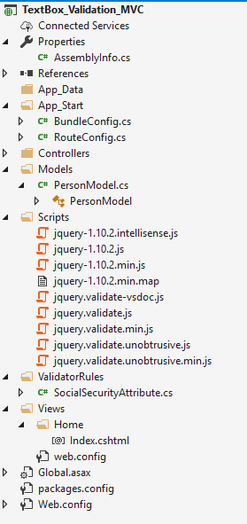
Project structure

Slide 27
ASP.NET Data Annotations
Data Annotation Validator Attributes
1. DataType Validates for particular data type e g. value should be numeric only,
2 DisplayName Specifies Display Name on View of property.
3. DisplayFormat Specifies Display Format of property value
4.Required Value must be provided to the model property.
5. Range Data should be in specific range like Customer Age should be between 20 and 40.
6. StringLength You can specify minimum and maximum length of properly value.
7. MaxLength You can specify only maximum length of property value.
8. RequIarExpression Value should match regular expression e g. email, phone, url etc.
9. Bind specify fields to include or exclude for model binding.
10. ScaffoldColumn It Is a boolean property, specifies if the value should be hidden on view.
11. EnumDataType Value should match with one of the enum member.

Slide 28
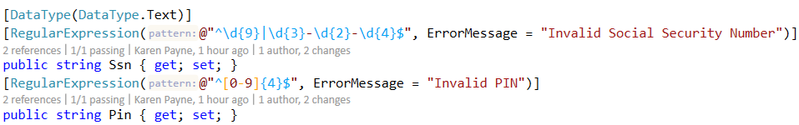
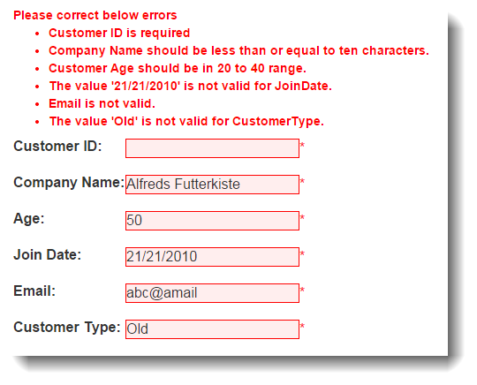
ASP.NET Data Annotations

Slide 29
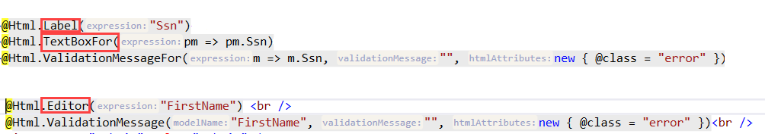
Generating HTML
Various extension methods provide ways to generated HTML

Slide 30
Telerik ASP.NET Core
https://demos.telerik.com/aspnet-core/

Slide 31
Entity Framework
Entity Framework is an object-relational mapper (O/RM) that enables .NET developers to work with a database using .NET objects. It eliminates the need for most of the data-access code that developers usually need to write.
https://docs.microsoft.com/en-us/ef/#pivot=entityfmwk&panel=entityfmwk1

Slide 32
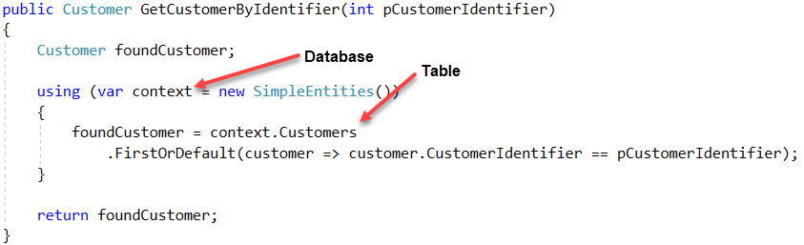
Entity Framework Reading data (simple)
Read data by primary key

Slide 33
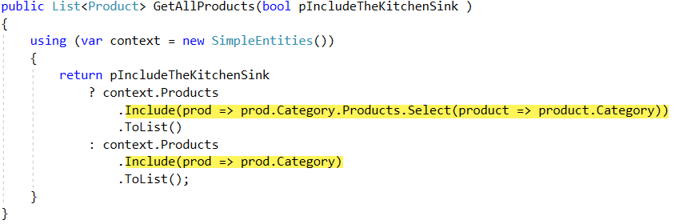
Entity Framework Read taking control
Loading navigation properties

Slide 34
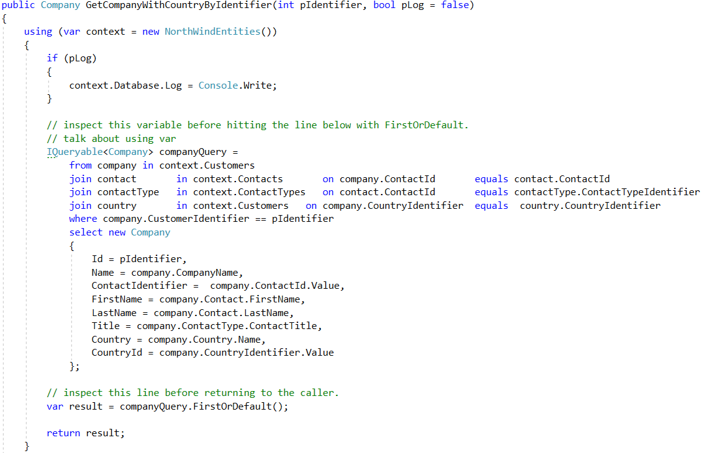
Entity Framework joins

Slide 35
Entity Framework Tracking vs No-Tracking
Tracking behavior controls whether or not Entity Framework Core will keep information about an entity instance in its change tracker. If an entity is tracked, any changes detected in the entity will be persisted to the database during SaveChanges(). Entity Framework Core will also fix-up navigation properties between entities that are obtained from a tracking query and entities that were previously loaded into the DbContext instance.

Slide 36
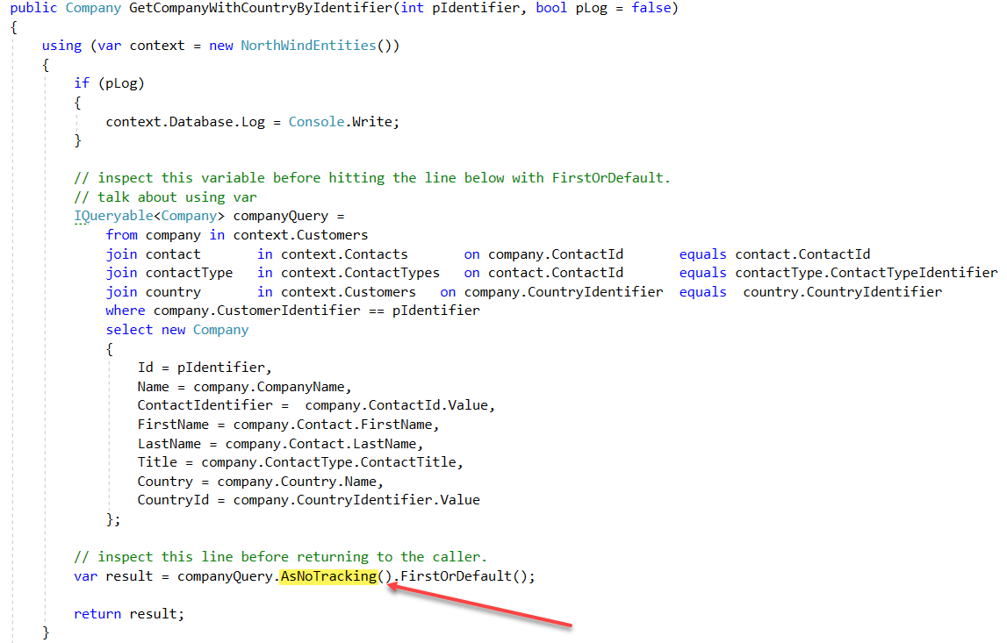
Entity Framework – No-Tacking

Slide 37
Entity Framework loading
Lazy loading is delaying the loading of related data, until you specifically request for it.
Eager loading is the process whereby a query for one type of entity also loads related entities as part of the query, so that we don't need to execute a separate query for related entities. Eager loading is achieved using the Include() method.

Slide 38
Entity Framework – raw queries
Entity Framework Core allows you to drop down to raw SQL queries when working with a relational database. This can be useful if the query you want to perform can't be expressed using LINQ, or if using a LINQ query is resulting in inefficient SQL queries. Raw SQL queries can return entity types or, starting with EF Core 2.1, query types that are part of your model.
In EF6
var demo = context.Countries.SqlQuery("TODO").ToList();

